Slide 1


How not to revise
Students often end up drifting into patterns of behaviour which undermine the effectiveness of revision.
They waste hours of time and see little benefit, which can weaken motivation and increase anxiety.
How many unhelpful features can you spot here?
Y11 Assembly

Slide 2

Getting the basics right
Make revision more formal
Sitting at a table or desk
Get rid of clutter
25-30 mins active revision
Scheduled breaks of 5-10 mins

Slide 3




Getting the basics right
Remove distractions
Mobile turned off
No music or TV
Short breaks – not 3 hours gaming!
Not on a computer*
*except where specifically instructed by subject teacher

Slide 4




Getting the basics right
Look after the body
Stick to proper meals rather than sugary snacks
Take some exercise when you take a break
Ensure sensible sleeping patterns –
8-9 hours a night

Slide 5
Revision = practice over time
Avoid making excuses
“There’s no point trying.” Not trying is the only real failure!
Every bit of revision helps.
“I don’t know what to revise.” Speak to your teacher!
They will be keen to help you.
“I’ll do it tomorrow*” Putting it off makes it harder!
* Or the day after that … Start today!

Slide 6



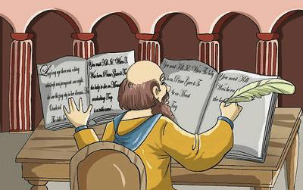
We remember what we think about
Avoid fooling yourself
‘Just reading’ isn’t effective
Avoid passive activities like highlighting or copying

Slide 7
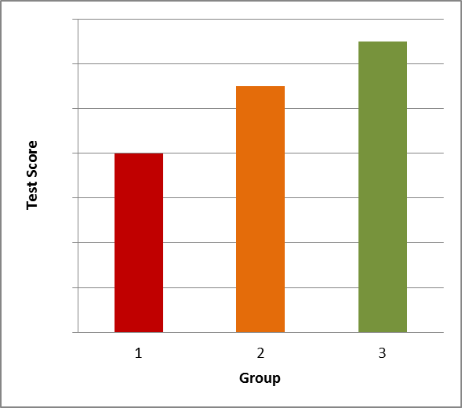
Test yourself
Group 1 S S S S
Group 2 S S S T
Group 3 S T T T
S = Study session
T = Practice test
Final test 1 week later

Slide 8
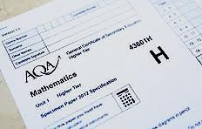


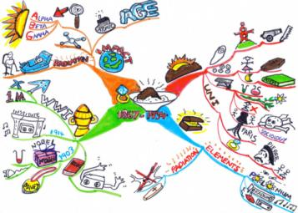
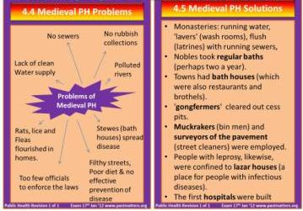
Test yourself
How to test yourself
Tackle example questions from memory
Then check and improve answers
using revision guide / book
Cover and reproduce
from memory
Test yourself using flash cards
or visual maps

Slide 9
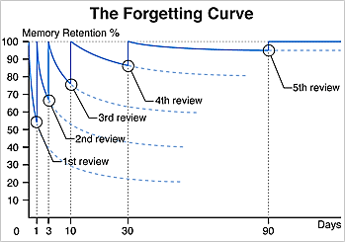
Revision = practice over time
Each time you revise material, you learn it faster and recall it better

Slide 10
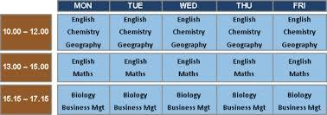





Revision = practice over time
Building up your memory
Spread it out -
Distribute revision for a subject over several weeks
Mix it up –
Revise 4 different subjects for 30 mins each, rather than 2 hours on one subject

Slide 11
Summary
How not to revise!
Studies show that many students adopt ‘bad habits’ when revising.
Don’t Listen to music or have the TV on in the background
Don’t Let your phone distract you (turn it off!)
Don’t Procrastinate (waste time or put off revision)
Don’t Leave revision to the last minute
Don’t Just read or highlight

Slide 12
Summary
The two best strategies for revision:
Do Test yourself from memory
Do Repeat this over several weeks

Slide 13

Final word!
It’s natural to get a bit anxious about exam performance – but avoiding revision only makes the feelings worse!
The best cure for exam nerves is doing effective revision – you’ll feel much better prepared.
Revision isn’t about getting a certain grade, but about genuinely trying your best
Effective revision always pays off!

