Slide 2
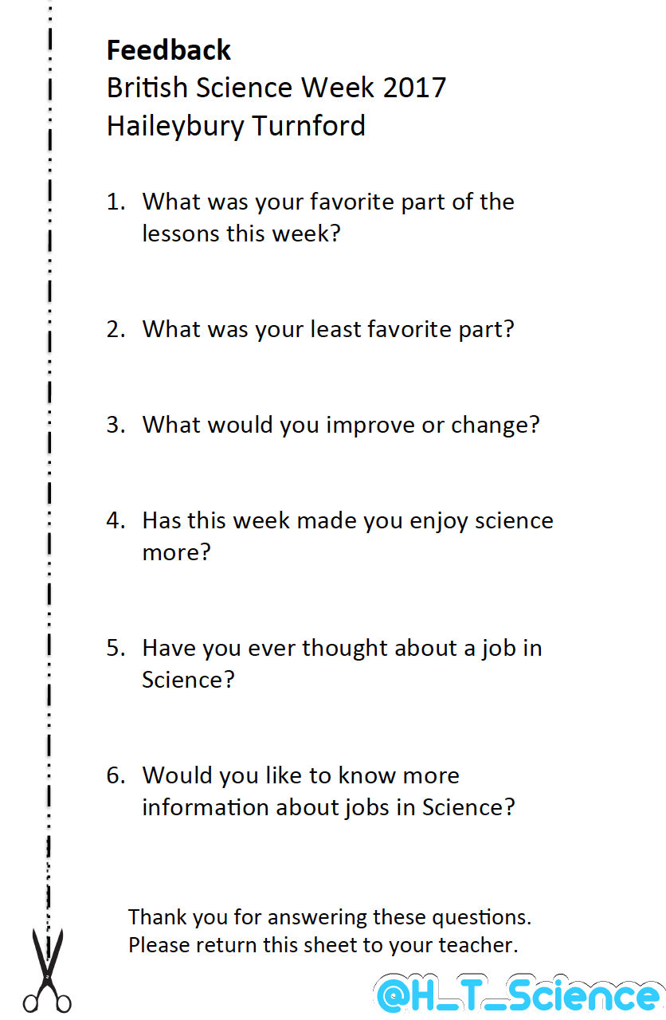

Slide 3
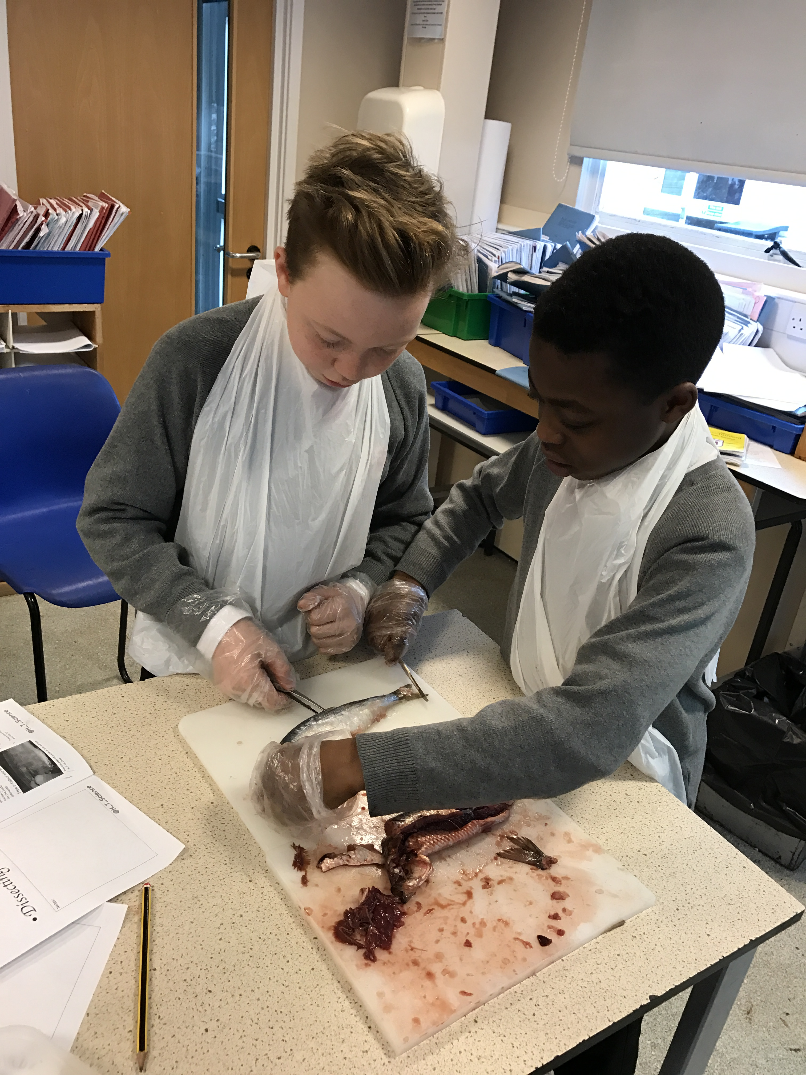
What was your favourite part of Science week?

Slide 4
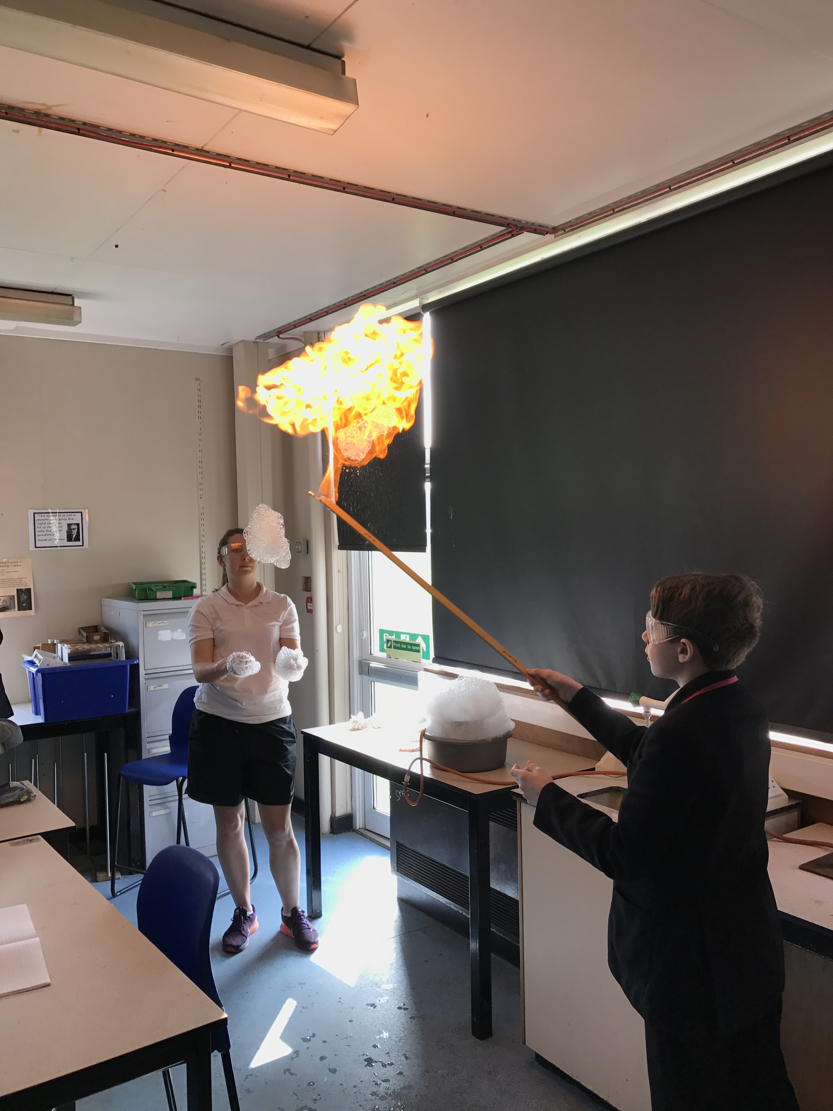
Would you like to know more about jobs in Science?

Slide 5
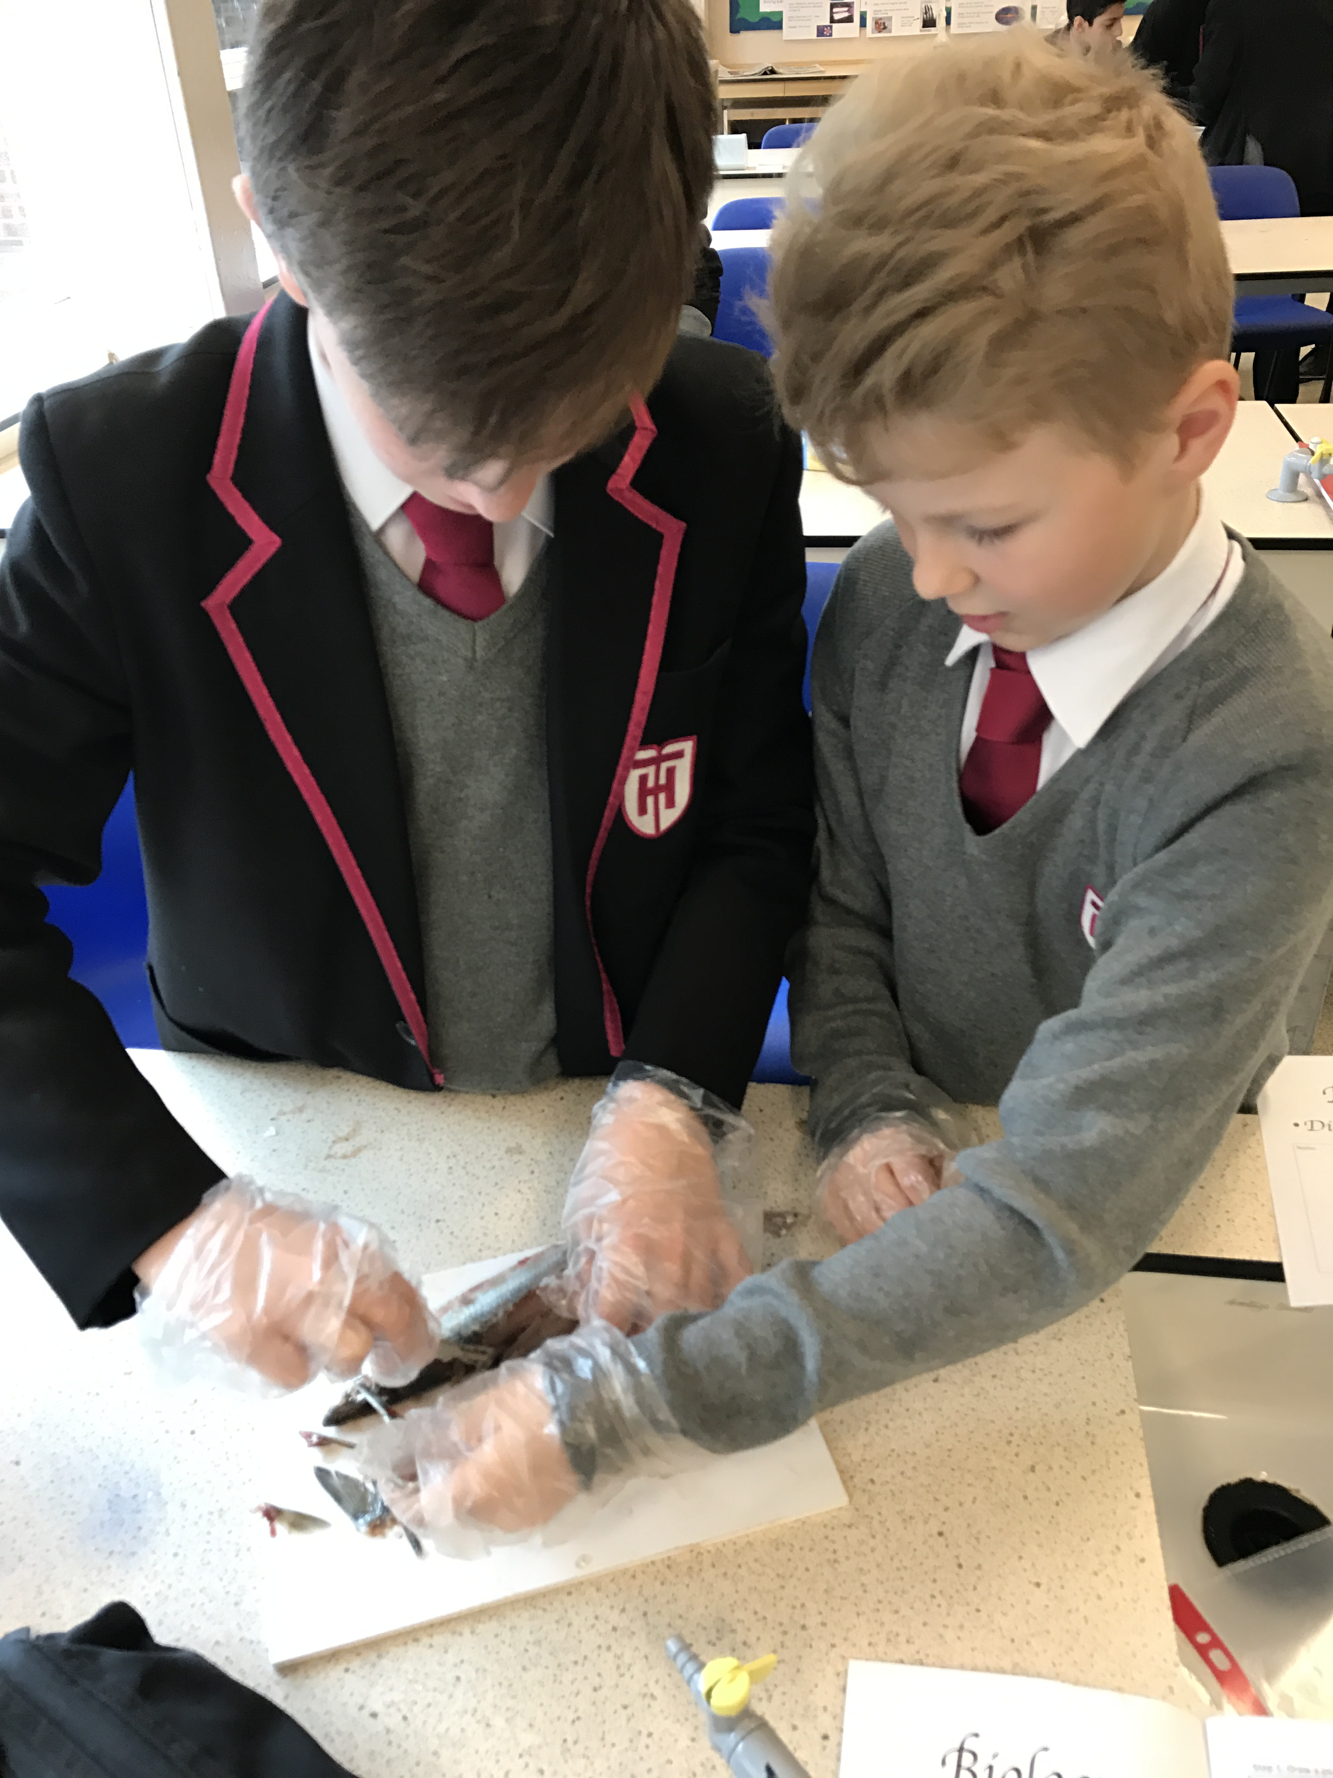
Has this week made you enjoy Science more?

Slide 6
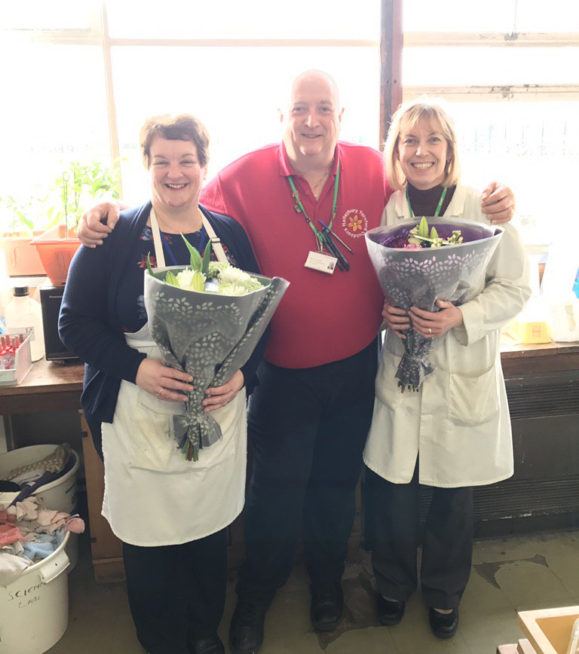
Other comments:
‘’I loved the practicals’’
‘’I really enjoyed the videos that explained how it would be used in real life’’
In response to the question – Have you ever thought about a job in Science?
‘’Yes as everything involves Science’’
Our fantastic technicians

