Slide 1
Duke of Edinburgh
2019 Cohort

Slide 2
What is the Duke of Edinburgh Award?
The Duke of Edinburgh ( DofE) award is a real adventure from beginning to end.
You can do programmes at three levels, Bronze, Silver or Gold.
You achieve an Award by completing a personal programme of activities in four sections

Slide 3
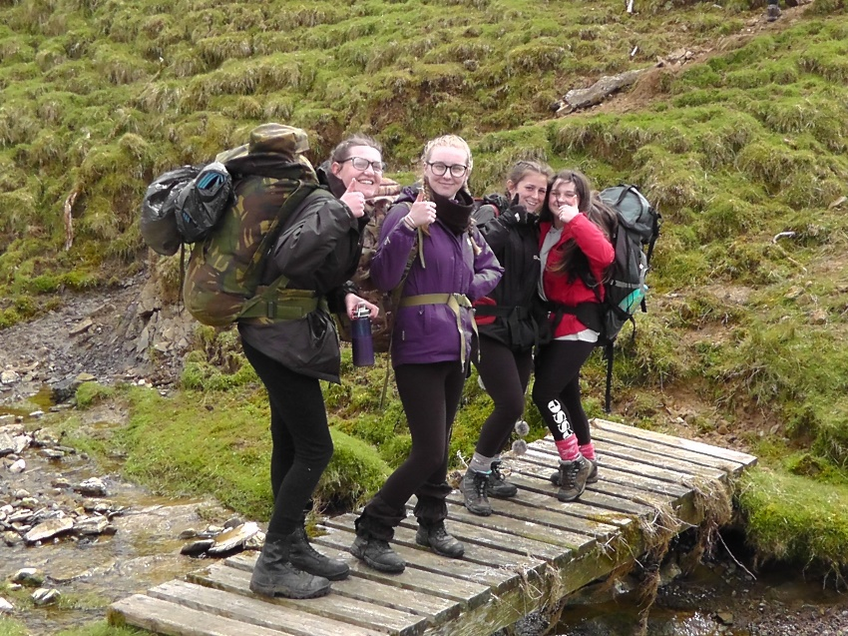
Why do Duke of Edinburgh?
Along the way the young people pick up experiences, friends and talents that will stay with them for the rest of their life.
Colleges, 6th forms, University and employers all value the award highly.
The challenge
Fun!
Be away from your phone!

Slide 4
Skills and Values
Map Reading skills
Independence
Navigation
Camp craft
Organisation
Self belief
Confidence
Determination
Team work
Consideration
Self motivation
Healthy living/lifestyle
Fitness improvement
Self awareness
Appreciation
Cooperation
Communication
First aid skills
Part of a community

Slide 5
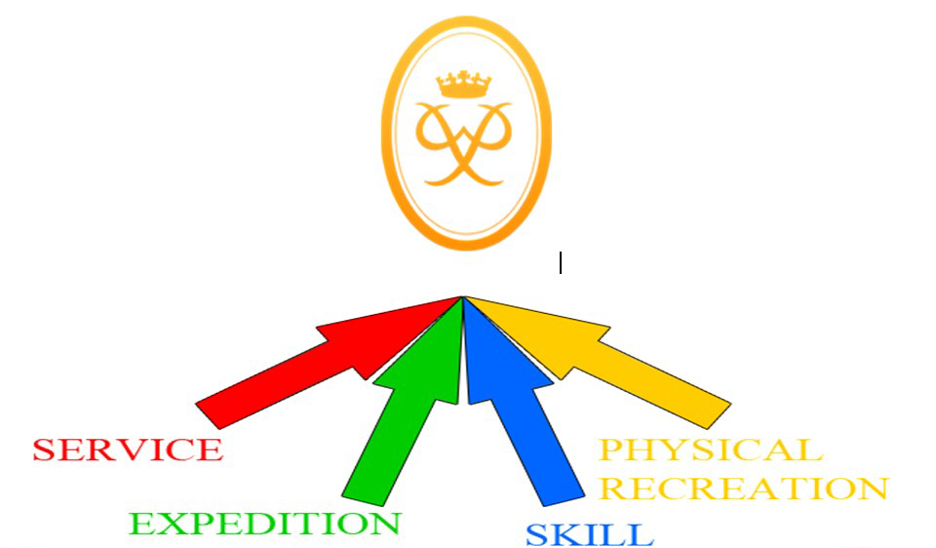
4 sections
Physical
Skills
Volunteering
2 of these sections need to last 3 months
1 of these sections needs to last for 6 months
Expedition
Young people go on 2 expeditions where they learn a variety of skills

Slide 6
Physical
This could be a new activity or an existing activity that your child already does.
Set themselves targets
Weekly activity (about 1 hour per week)
Family members cannot assess
Dance
Golf
Football
Karate
Swimming

Slide 7
Volunteering
This must be unpaid work (not a part time job)
Helping / giving back to the community
Parents cannot be the assessor
It could be:
Caring for
the Environment
Charity work
Community
Awareness
Working
with animals
Coaching

Slide 8
Skills
This could be a new skill or a current skill that can be developed further
Set themselves targets
Weekly activity (about 1 hour per week)
Family members cannot assess
Hobby – not within lessons
Film making
Art
Photography
Animal care
Cooking
Collecting
Guitar
DIY
Pottery
Cooking

Slide 9
Evidence for these sections
BIGGEST BARRIER
A weekly log signed by the assessor
Photographs / videos / written reports
An assessors report – they must have one of these for each section in order to pass.
Students get an app to record this information

Slide 10
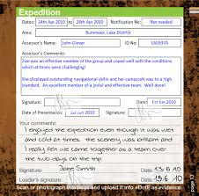
eDofE
Students will record their progress for each section online – monitored by staff
They will have to upload evidence to prove they are completing each section (photographs, videos, a diary signed by the assessor)
When completed they will need to get an assessors report – can be done via the eDofE app!
Training will be given by County to start with.
www.edofe.org/login

Slide 11
Expeditions
Training sessions– to make sure the students are prepared for the expeditions
These are not voluntary and must be attended:
First aid
Expedition specific equipment
Map reading
Emergency situation
Country code
Team work

Slide 12
Expeditions
Two day practice walk
Hertford area
Two day assessed expedition
Chiltern Hills
Must have a focus
No student will be permitted on the assessed expedition without full training and completion of 2 sections

Slide 13
Expeditions
We provide all specific equipment
Tents, stoves etc.
Hire out some other equipment
Rucksacks, sleeping bags, role mats
We have access to more equipment from Haileybury
Walking boots, waterproofs etc.
You might want to purchase
Walking boots, specific clothing etc.
At the end of the assessed expedition each group will need to make a presentation about their experiences and their focus to a small audience including their group leader

Slide 14
Commitment
DofE is a HUGE commitment
Parental support is crucial
Plan regular activities
Try not to do all sections at once

Slide 15
Sessions
Once you’ve started the programme
Must take part in Tuesday activities – 3pm – 4pm – start date TBC
Volunteering / Physical / Expedition training
Start a physical or a skill immediately

Slide 16
Application
Complete an enrolment form
Short letter of application
Why you should be enrolled onto the programme
What you hope to get out of the programme
If successful, students will receive a letter of acceptance

Slide 17
Money
£35 – ParentPay.
Enrolment fee
County Council admin charge
Only payable once accepted onto the programme
Expedition costs
TBC – normally around £65

Slide 18
Welcome Packs
Once you have registered on eDofE (in school session) in the New Year
Will be sent direct to your home address
The Welcome Packs each include five main elements: – Information for participants – Information for parents and carers – Participant’s DofE Card – Assessors’ cards – A guide to choosing expedition kit.

Slide 19
Any questions?
www.dofe.org

