Slide 1
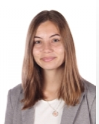
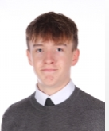
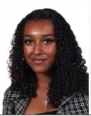
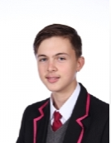
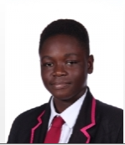
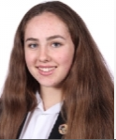
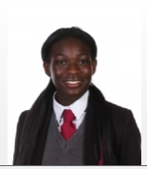
Who are the Student Leadership Group at HT?
Head Students -
Rebecca Fletcher, Y13
Jamie Curry, Y13
Tate Lambie, Y12
Gracie Green, Y11
Henry Atkinson, Y11
Richmond Amoako, Y10
Havana Marshall, Y10
Britney Siaw, Y9
Notes:
Good morning – today we will be presenting the assembly and the first part of the assembly will aim to introduce and explain the role of the student leadership group here at HT. The second part of the assembly will focus and introduce ideas about how the school will be supporting anti bullying week this year.
The student leadership group is led by our Head Students in the Sixth Form – Rebecca and Jamie and alongside our Head Students are a number of representatives from across the school from Y9-Y12.
Shown here on this slide are the current student leaders and our aim is to represent the views of all students on important issues and things that matter to our school. Our aim is to plan for opportunities for student voice to be listened to and for your suggestions and views to support and contribute towards promoting whole school events and student wellbeing. We aim to plan regular opportunities for all students to feedback on school life including teaching and learning, wellbeing provision, homework, co-curricular activities and rewards. Your views and suggestions are important to help support school leaders to provide and continue to create an inclusive school where everyone feels safe and welcome in the school. We believe we have an important role in helping to make decisions across the school and we would like to be your representatives to make sure that student views are listened to and taken into consideration to help to continue to improve our school for everyone here. We will aim to gather student feedback through different ways – for example – surveys posted on class charts or small focus groups with representatives from each year group to find out your views about important issues.
We will have meetings every half term where we will have an opportunity to discuss and bring forward key issues and discuss ways in which the school can continue to improve and will be able to present these views to the leadership team and governors.
It is not our individual views which are important but the views of you and all of us as a student group which are important and we aim to listen to and bring forward during our meetings.

Slide 2
Student Leadership at HT
The new catering provision – student voice feedback and suggestions to improve this provision
Proposals and suggestions for the new catering food pod
Wellbeing garden
Cultural buffet
Anti-bullying week
Notes:
Our first meeting of the Student Leadership Group was held on 11.10.22 and we discussed the following agenda items:
Add description of meeting and planned actions

Slide 3
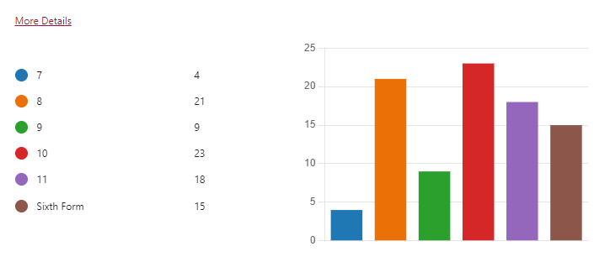
Student Leadership at HT
Notes:
Student voice feedback on the new catering provision – last half term a survey was circulated to all students across the school to gather your views and feedback about the new catering provided by Aspens caterers at school. 90 students from Y7-13 responded to this survey. We would like to take this opportunity this assembly to share the responses and plan of action the Student Leadership Team will take up based on your views.
This slide shows the number of students from each year group who answered and completed the survey – which was sent to all students on class charts.
The majority of students who answered the survey were from Y10 and Y8

Slide 4
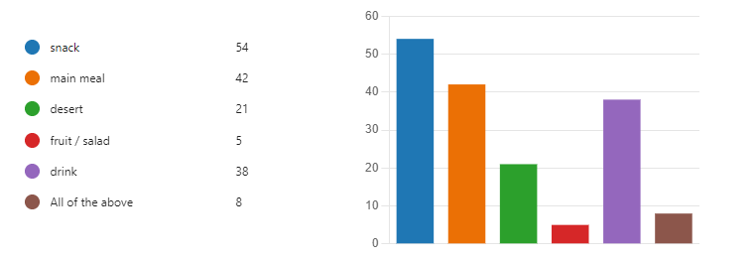
Notes:
From the student survey we found out that most students are likely to purchase food from the restaurant or canteen at break time and or both break and lunchtime and that most students who answered the survey purchased a snack followed by a main meal and then a drink. The majority of students who completed the survey felt that it was important the caterers offer healthy foods and over 50% of all students who answered the survey felt that the quality of food purchased in school was fair to excellent.

Slide 5
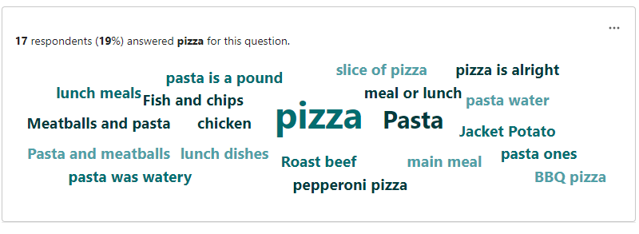
Notes:
When asked about your favourite foods served at the canteen these were some of the responses given – shown on this slide. Pizza is clearly a popular choice with 19% of students answering pizza for this question.

Slide 6
Notes:
We asked about other healthy foods and drinks you would like to see provided and on the menu and these are some of the answers you gave shown here …
Just over 10% of the answers mentioned that they would like to see smoothie drinks provided as an option.

Slide 7
Notes:
Another question asked respondents to rate the current queuing system and 56% of you rated the current system for queuing as fair to excellent. The survey also asked about any general recommendations or comments to help improve our catering provision and service and some of the responses are shown on this slide.

Slide 8
Next steps …
Share the results from the student survey with the Business Manager and Catering Manager and Aspens Caterers to recommend changes and improvements
Rotate the queuing system
Introduce alternative arrangements for queuing in the winter months
Plan to gather student voice and feedback about the new catering service later in the year
Notes:
After considering the student feedback from the survey we decided it would be important to feedback and share important points in a meeting with the Business Manger (Ms Howard) , the catering manager (Miss Cable) and the manager from Aspens catering services. This meeting is planned to take place on XXXXXXX. We will make recommendations and suggestions based on your feedback. We will be discussing some of the proposals and will ask Aspens to consider the following recommendations:
Introducing fruit slushies or smoothies
Offer a selection of halal food for students who wish to purchase this
Offer a meal deal and special price every so often and ideally once a week on a selection of foods and drinks
Offer foods unique to certain festivals and celebrations
Offer hot chocolate as an optional drink
Offer a variety of fresh fruits and cereals
In addition to these suggestions – the school has made changes to the queuing system and has changed the rotation for when certain year groups can enter the dining hall to make the system fairer. The school has also changed the queuing system for the winter months to make sure students are not queuing outside without shelter for longer periods than necessary.
As well as meeting with the catering, business and Aspens catering manager we are also considering how the new wellbeing garden (previously the kitchen garden in between the buildings of the H building) can be used as a resource to support students mental health and wellbeing. If you have any suggestions to make about how we can continue to improve our catering facilities please look out for the next student survey later this year or share your ideas with one of us …

Slide 9
Anti Bullying Week 14th – 18th November
1 in 25 people will experience bullying at some point in their lifetime
Bullying comes in all shapes and sizes
Bullying can cause people to feel anxious, hurt, humiliated and intimidated
The theme for anti bullying week this year is one kind word
Notes:
Bullying is something that 1 in 2 people under 25 will experience in their lifetime, but it is a behaviour that we often find difficult to define.
The reason why it’s so hard to pin down and give a clear definition of bullying is because it comes in all shapes, sizes and subtleties, and there are a huge number of misconceptions around it.
Many types of bullying such as spreading harmful rumours, online abuse, and subtle bullying within friendships such as manipulation, intimidation and social exclusion,
are dismissed or not seen as bullying behaviour – but they still cause people to feel anxious, hurt, humiliated and intimidated.
This week is anti-bullying week, and so we are taking a look at the reasons why people bully, and how we can respond. The theme for this week's anti bullying week is about reaching out and helping others who may be experiencing bullying.
Understanding about what bullying is how you can respond to bullying and how you can prevent bullying is an important way you can develop the HT student character traits shown here.
We will be considering the question shown on the next slide …

Slide 10
Notes:
So why do people bully? Can anyone suggest an answer to this question – ask the audience!

Slide 11
57% attitudes towards my appearance
40% attitudes towards my interests or hobbies
24% attitudes towards the clothes I wear
20% being accused of being gay/lesbian when I am not
19% attitudes towards my mannerisms
18% attitudes towards my high grades
14% attitudes towards my low grades
11% attitudes towards a disability I have
Notes:
The Annual Bullying Survey 2021 showed that people who had experienced bullying this year felt that they were being bullied for a number of different reasons.
These ranged from attitudes about their appearance – which made up over half of their experiences – to attitudes about their hobbies, their clothes, their school grades and more examples shown here.

Slide 12
People who perpetrated bullying this year said they did it because ...
59%
“They deserved it”
55%
“I don’t like them”
34%
“It’s funny”
Notes:
When people who perpetrated – or did the bullying were asked about their reasons for doing it, the top three responses were that people ‘deserved it’, they ‘didn’t like them’ and ‘it’s funny’.

Slide 13
Notes:
But the thing is – none of the explanations given are true

Slide 14
Notes:
No matter who you like, what you wear, how you look, or what you do in your spare time, you never deserve to be bullied for who you are.

Slide 15
Notes:
Being bullied has nothing to do with the person being bullied, and everything to do with the person who is doing the bullying.

Slide 16
SO WHY DO PEOPLE REALLY BULLY?
Notes:
In a recent national study, 8,850 respondents were asked intimate questions about their lives. Their answers were compared against those who had never bullied, those who had bullied at least once, and those who bully others daily, giving very strong and factual data to identify the real reasons why people bully others.
So, why do people bully?

Slide 17
People who perpetrated bullying this year are much more likely to have experienced …
STRESS AND TRAUMA | INSECURE RELATIONSHIPS
DIFFICULT HOME LIVES | LOW SELF ESTEEM
Notes:
The data shows that those who bully are far more likely than average to have experienced a stressful or traumatic situation in the past 5 years. While some people deal with stress in positive ways, others use negative behaviours such as bullying. These might temporarily mask the issues but usually make them worse in the long-term. The results also showed that those who have experienced bullying are twice as likely to go on and bully others.
Those who bully are more likely to feel like their friendships and family relationships aren’t very secure. 1 in 3 of those who bully people daily told us that they feel like their parents don’t have enough time to spend with them, and they are also much more likely to come from violent households with lots of arguments.
It’s not surprising then that more than half of those who bully suffer from anxiety and many have low self-esteem. In order to mask how they actually feel about themselves, some people who bully focus attention on someone else. They try to avoid any negative attention directed at them by deflecting.

Slide 18
Notes:
This all shows us that no-one is born a victim, and no-one is born a bully. Bullying is a learnt behaviour and not an innate characteristic of anyone, so it’s important not to define yourself by your actions and experiences. You are more than a label and it’s up to you who you choose to be.

Slide 19
Notes:
Research proves that the reason 1 in 2 people get bullied is nothing to do with ‘deserving it’ or being different. Being bullied is never your fault. You are great as you are, and you are not alone.
And if you’re doing the bullying? The research shows that those who are carry out bullying behaviour are equally in need of support.

Slide 20
DON’T BLAME YOURSELF.
DON’T IGNORE IT.
DON’T GO IT ALONE.
BULLYING ENDS HERE.
Notes:
So, what are the most important things to remember? Don’t blame yourself and don’t ignore it. Whether you’re experiencing bullying, you’ve witnessed it or if you’re perpetrating it; speak up. Talk to someone and make sure you let people know what’s happening.
Whether that’s through online support, through the school and your pastoral team, tutors or teacher or your friends, don’t suffer in silence - you need to know that you’re not alone.

Slide 21
Notes:
Don’t put up with bullying make sure you speak to a trusted member of staff or a friend.
This year’s theme for ABW is about reaching out – bullying affects millions of lives but if we challenge it we can change it and it starts by reaching out. Whether it’s in school, at home, in the community or online, let’s reach out and show each other the support we need. Reach out to someone you trust if you need to talk. Reach out to someone you know is being bullied. We all have a responsibility to help each other reach out. Together, let’s be the change we want to see. Reflect on our own behaviour, set positive examples and create kinder communities.
We would like to finish this assembly with a short video clip and message for everyone …
Thank you for listening.

