Slide 1
Making an Informed Choice
Notes:
Today I wanted to talk about vaping as it has grown in popularity all over the world and by people of different age groups.
Vapes come in all shapes and sizes and there are many flavours to choose from – the marketing of vapes makes them look attractive and appealing
We wanted to give an assembly where hopefully you will have the facts and information so you are informed and can make your decisions based on evidence.
There are a lot of myths out there about vapes and vaping and it’s a relatively new thing that has not been around for a long time as is the case with cigarettes
Not every one knows about the potential health risks vapes and vaping can cause because of the chemicals and substances contained with the vape liquid whereas we are all aware of the risks associated with smoking cigarettes. But here’s the thing - there is more research being collected and carried out by independent researchers who are not connected to the vaping industry and so the data is more accurate and not biased. There does seem to be evidence which shows vaping can have some serious and dangerous health risks and side effects and we think it is important you know about these.

Slide 2
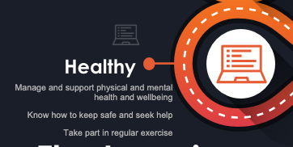
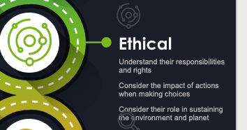
How does this assembly link to the HT Student and British Values?
Notes:
How does all of this link to the HT student – you are familiar with and the way in which we want to aim to support you in the way you develop personal characteristics and qualities throughout the curriculum – we are focusing on how having the right information can help you to make the right decisions and choices to be healthy, physically and emotionally based on independent choices and decisions and not through feeling pressured by others or the media.

Slide 3
E-cigarettes
Who and how did the first e-cigarette come into existence?
When were e-cigarettes introduced to the UK?
Why did they become popular so quickly?
Notes:
The first e-cigarette was developed by a pioneering Chinese pharmacist Hon Lik – who had lost his father to lung cancer – he had been a smoker of cigarettes and Hon Lik wanted to develop a device which could deliver nicotine but not the other harmful chemicals found in cigarettes. It was very popular and grew rapidly in the Chinese market and soon began to filter out to the rest of the world – it came to the UK in 2005 and USA in 2007.
Because they are relatively new invention – little was known about the side effects and long-term health concerns which may come about from vaping
Most vape liquids contain nicotine even if it is not listed as one of the ingredients and nicotine is a highly addictive substance. One of the myths is that nicotine is not harmful but new research is suggesting this is not the case.

Slide 4
Vaping is more harmful than you think
https://youtu.be/kGj5HkjRmz0
Notes:
Vaping has become very popular over a relatively short space of time.
In only 8 years the rate of 11-18 year old's vaping had increased by 32% - vaping has increased in popularity in young people – and even young people who have never tried cigarettes or any other types of smoking ...

Slide 5
Vaping is more harmful than you think
Vaping has significant side effects
Vape liquid contains toxic, metal particles and carcinogenic chemicals
The devices can be dangerous – injuries due to the batteries in the device
They can cause respiratory illnesses
They contain a higher concentration of nicotine
Vaping can cause lung injury
Vaping can affect your mental health and wellbeing

Slide 6
Why do young people vape?
Curiosity about the flavours
Vapes are made to look attractive and fun
Wanting to fit in
Believe they are less harmful than cigarettes
Easier to get and cheaper than cigarettes
Existing mental health issues – self medication
Becomes habitual overtime
Notes:
Over time, vaping can become habitual as it is used to address other needs such as relief from boredom and anxiety.
Some also become addicted to nicotine and continue vaping to avoid withdrawal symptoms.

Slide 7
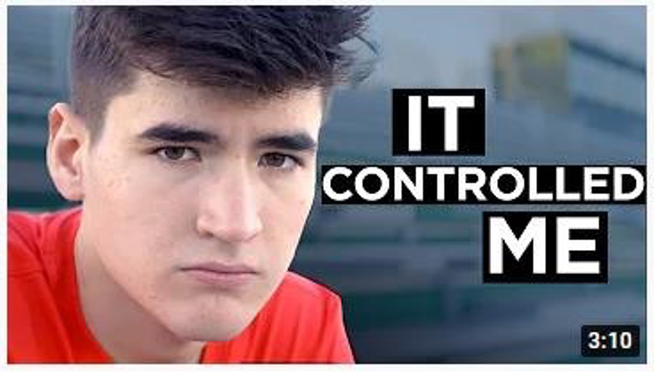
It controlled me
KS4
https://youtube/jpKMWFaptwE

Slide 8
Feeling pressured to give vaping a try?
Say with direct eye contact and assertive body language
“No thanks, I’m not interested,”
“You guys can, but I don’t want to.”
“No thanks, vaping isn’t for me.”
“No, not my thing thanks.”
Notes:
Know your own mind and make sure that you are able to express yourself. If you want to say “no” then make sure you are able to say this.
Remember that there is a high chance that others you are with are also feeling pressurised, so if you are able to say “no” then you could be helping them to say “no” as well.
Giving in to peer pressure reflects low self-esteem and the idea that what others want is more important than what you want. No-one is more or less important than you!

Slide 9
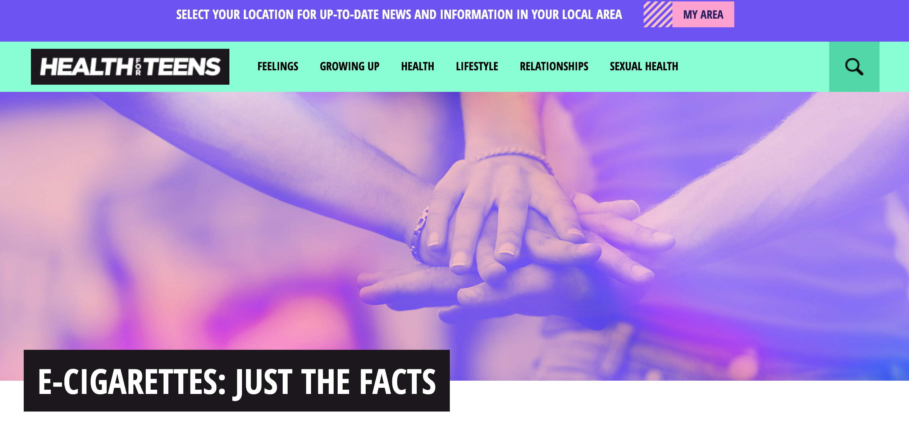
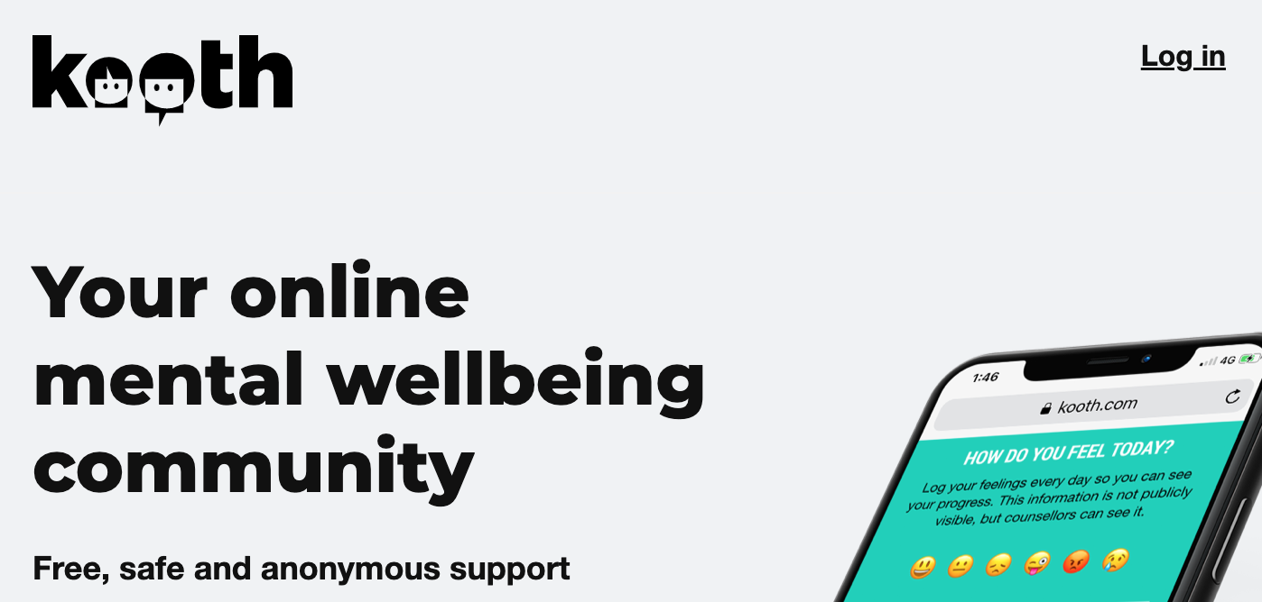
Getting Help
Is vaping affecting my health?
Is vaping controlling my life?
How does vaping affect the way I think and feel?
How does vaping affect my relationships with my friends, parents, boyfriend/girlfriend, or other people important to me?
How does vaping or thinking about vaping interfere with my schoolwork or grades?
Are there activities that I used to enjoy that I don’t enjoy anymore because of vaping?
Am I spending a lot of money to keep vaping?
What am I looking forward to the most after quitting?
Notes:
If you do vape - there are many good reasons to stop vaping. Do you want to feel healthier? Save money? Knowing why you want to quit vaping can help you stay motivated and focused on your goal to become vape-free.
Think about the things in your life that are important to you. Does vaping get in the way of what’s important? If you’re not sure, try asking yourself these questions:
Is vaping affecting my health?
Is vaping controlling my life?
How does vaping affect the way I think and feel?
How does vaping affect my relationships with my friends, parents, boyfriend/girlfriend, or other people important to me?
How does vaping or thinking about vaping interfere with my schoolwork or grades?
Are there activities that I used to enjoy that I don’t enjoy anymore because of vaping?
Am I spending a lot of money to keep vaping?
What am I looking forward to the most after quitting?
Tutors / trusted adult can support at school and help

Slide 10
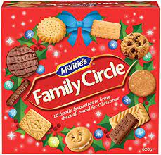
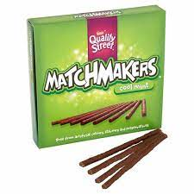
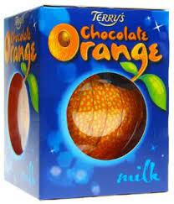
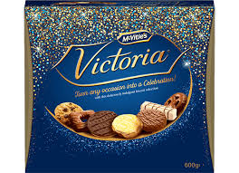
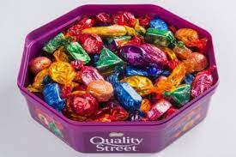
CHRISTMAS FOOD PARCELS
We would love you to donate an item of non-perishable food to make up our HT Christmas food parcels to give to families in need this year.
Please take your donation to Mrs Megaw’s room (H201) before 12th December.
Thank you ☺

