Slide 1
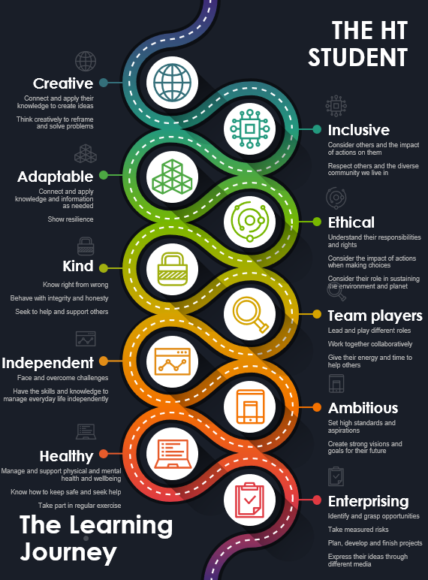
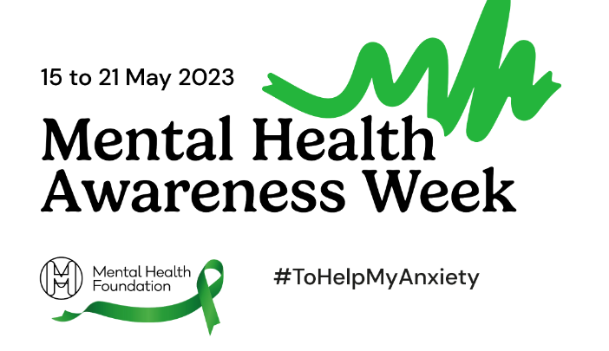
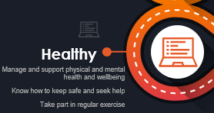
Notes:
Today's assembly will be focusing on the theme of the Mental Health Foundation Mental Health Awareness Week: Anxiety and links with our HT character traits shown on this slide.
Anxiety is a natural response to stress or perceived threats that involves feelings of uneasiness, worry, or fear. It's a normal and common human emotion that can be experienced by anyone, but for some people, it can become too much and interfere with their daily lives.
This assembly will look at ways you can support your mental health and particularly if you experience anxiety – the good news is there is a lot you can do to support yourself if you experience anxiety and there is a lot of support you can access.

Slide 2
Friendships, self esteem and general wellbeing
Ability to engage in learning
Behaviour and progress
Attendance
Notes:
This slide shows a spectrum of mental health the ideal zone to be in is obviously the healthy and green zone but sometimes when there are external and stressful events that we may not be able to control we may find our mental health moves into the coping struggling or even unwell zone – this can affect your attendance, behaviour, progress, friendships etc. The good news is that there are a lot of proven ways to keep your mental health in the healthy zone.

Slide 3
What is anxiety?
A feeling when we are worried, tense or afraid
When we think we are under threat
It can be experiences through our thoughts, feelings and physical sensations
Most people feel anxious at times
It is common to experience some anxiety during stressful times in your life
“For me, anxiety feels as if everyone in the world is waiting for me to trip up, so that they can laugh at me. It makes me feel nervous and unsure whether the next step I take is the best way forward.” Student, Y12
Notes:
Anxiety is what we feel when we are worried, tense or afraid – particularly about things that are about to happen, or which we think could happen in the future. Anxiety is a natural human response when we perceive that we are under threat. It can be experienced through our thoughts, feelings and physical sensations. Most people feel anxious at times. It's particularly common to experience some anxiety while coping with stressful events or changes, especially if they could have a big impact on your life.

Slide 4
What does anxiety feel like?
a churning feeling in your stomach
feeling light-headed or dizzy
pins and needles
feeling restless or unable to sit still
headaches, backache or other aches and pains
faster breathing
fast, thumping or irregular heartbeat
sweating or hot flushes
problems sleeping
grinding your teeth, especially at night
nausea (feeling sick)
needing the toilet often or less
Notes:
Anxiety feels different for everyone. You might experience some of the things listed below, and you might also have other experiences or difficulties that aren't listed here.
effects on your mind include - feeling tense, nervous or unable to relax • having a sense of dread, or fearing the worst • feeling like the world is speeding up or slowing down • feeling like other people can see you're anxious and are looking at you • feeling like you can't stop worrying, or that bad things will happen if you stop worrying • worrying about anxiety itself, for example worrying about when panic attacks might happen • wanting lots of reassurance from other people or worrying that people are angry or upset with you • worrying that you're losing touch with reality • rumination – thinking a lot about bad experiences, or thinking over a situation again and again • depersonalisation – feeling disconnected from your mind or body, or like you're watching someone else (this is a type of dissociation) • derealisation – feeling disconnected from the world around you, or like the world isn't real (this is a type of dissociation) • worrying a lot about things that might happen in the future – you can read more about these sorts of worries on the Anxiety UK website.

Slide 5
Notes:
We will watch a short video to learn about anxiety – anxiety is a natural response to stress or perceived threats – it involves feelings of worry fear or uneasiness – it is a normal and common emotion

Slide 6
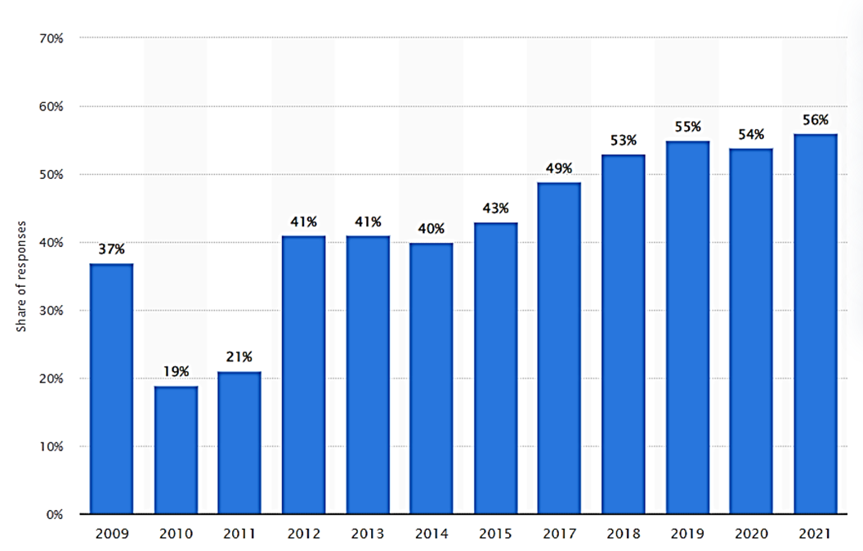
The rise of teenage anxiety
Notes:
In the UK the share of young people who experience feeling anxious has in general increased between 2009 and 2021. In 2021, 56% of young people surveyed reported anxious feelings, this was a marked increase from 19 percent in 2010.

Slide 7
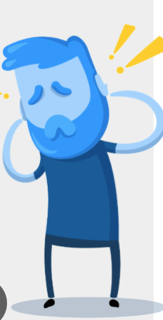
When is anxiety a mental health problem?
Notes:
Sometimes anxiety gets out of control and some of the indicators which may mean this is happening include the following
your feelings of anxiety are very strong or last for a long time
your fears or worries are out of proportion to the situation
you avoid situations that might cause you to feel anxious
your worries feel very distressing or are hard to control
you regularly experience symptoms of anxiety, which could include panic attacks
you find it hard to go about your everyday life or do things you enjoy

Slide 8
Top tips for overcoming anxiety: try the 4-7-8 breathing technique
The 4-7-8 breathing technique can help reduce anxiety by slowing down the breathing rate and promoting relaxation through the regulation of oxygen and carbon dioxide levels in the body.
Notes:
Do – it properly it works

Slide 9
Top tips for overcoming anxiety: Move more!
Notes:
Regular exercise can be a great way to manage and overcome anxiety. When we exercise, our bodies release natural chemicals called endorphins that help us feel good and reduce feelings of stress and anxiety. Exercise also helps to lower levels of stress hormones, like cortisol and adrenaline, which can make us feel more anxious.
Additionally, exercise can provide a healthy outlet for managing anxiety, as it allows us to release pent-up energy and emotions. It can also improve our sleep, which is important for overall health and well-being, and increase our self-esteem and confidence.
There are many studies which have shown that doing physical activity can improve mental health. For example, it can help with:
better sleep – by making you feel more tired at the end of the day
happier moods – physical activity releases feel-good hormones that make you feel better in yourself and give you more energy
managing stress, anxiety or intrusive and racing thoughts – doing something physical releases cortisol which helps us manage stress. Being physically active also gives your brain something to focus on and can be a positive coping strategy for difficult times

Slide 10
Top tips for overcoming anxiety: Get sleep and rest
Develop a consistent sleep schedule in a cool, comfortable, quiet and dark room
Avoid taking naps after school
Avoid using phones, laptops, or playing online or computer games, too late in the evening
Avoid rich foods, drinks or caffeine before bedtime
Exercise leads to better sleep
Notes:
Getting enough sleep helps our brain regulate emotions and respond to stressors in a calm way. Lack of sleep can increase anxiety and make it harder for us to deal with daily stressors. By prioritizing good sleep habits, we can help alleviate anxiety and feel more refreshed and energized for the day ahead.
To get good sleep, it's important to establish a consistent sleep routine, which includes going to bed and waking up at the same time every day. Avoid caffeine, nicotine, and electronic devices before bed, as they can interfere with sleep quality. Lastly, create a comfortable sleep environment by keeping your bedroom cool, quiet, and dark.

Slide 11
Top tips for overcoming anxiety: what foods can help you sleep?
Certain foods can help you to sleep or keep you awake at night
Foods high in sugar and caffeine can keep you awake at night
Foods high in tryptophan can help you to get to sleep
Avoid eating large meals before going to sleep
Notes:
Bananas before bed provide rich muscle-relaxing minerals. Bananas also contain the amino acid trypt-o-phan which helps sleep.
Toast effects insulin levels, which appear to play a role in regulating your body’s sleep-wake clock
Kiwi fruit are rich in serotonin and antioxidants, both of which may improve sleep quality when eaten before bed.
Cherries are high in melatonin, a sleep-inducing hormone. Cherry Juice has the same affect.
Brazil nuts are an excellent source of selenium, a mineral that helps you get a restful sleep.
It's also important to avoid eating large meals right before bed because your body needs time to digest the food. Eating a heavy meal before bed can make you feel uncomfortable and make it harder to fall asleep.

Slide 12
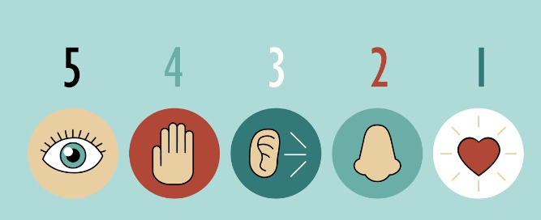
Top tips for overcoming anxiety: the 5-4-3-2-1 grounding technique
Notes:
When you're feeling anxious and overwhelmed, practicing a grounding technique can help bring your thoughts back to the moment.
Below is a grounding technique to follow along with. As you take part, try to take in small details of the environment around you and notice details that your mind usually won't pick up, such as the feel of objects around you or sounds in the distance.
5- things you can see – colours shapes hands sky
4 – things – feel clothes on your arm
3 things – hear clock ticking
2 things smell – perfume food
1 thing taste – last meal snack in a minute

Slide 13
Top tips for overcoming anxiety: Appreciate the world around you
Notes:
Spending time in nature can also increase our levels of serotonin, which is a neurotransmitter that makes us feel happy and content. When we have higher levels of serotonin, we're more likely to feel happy and content. It also reduces cortisol which can help us feel less anxious and more at ease.
Appreciating the natural world can also help us feel more connected to something larger than ourselves and gives us a feeling of purpose and belonging.
So, whether it's taking a walk in the park, going for a hike, or just spending some time outside, appreciating the natural world can be a really effective way to lower your anxiety levels.

Slide 14
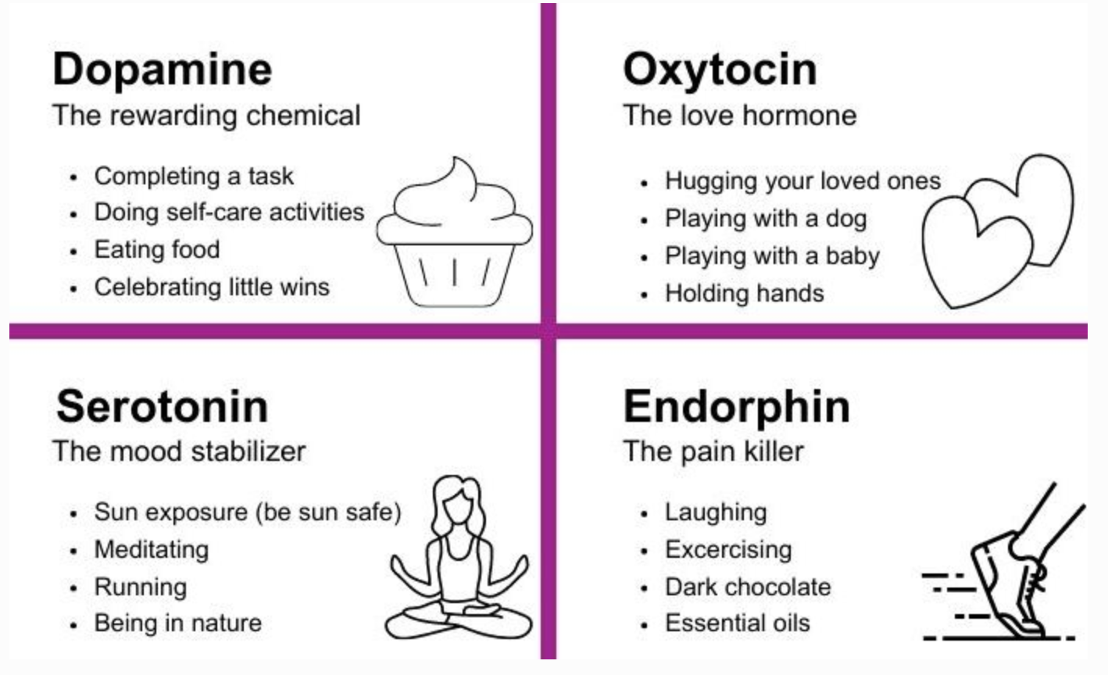
Top tips for overcoming anxiety: Connect with people that matter
Connect with others to create a sense of belonging and support
Participating in social activities can release feel-good hormones in the brain
Can help to build social skills and self-confidence
Notes:
Socializing and connecting with others can help reduce anxiety by distracting your mind from worries and negative thoughts, and by providing a sense of belonging and support.
Talking to friends or participating in social activities can also increase the release of feel-good hormones in the brain, which can improve mood and reduce stress.
Additionally, socializing can help you build social skills and self-confidence, which can help you feel more comfortable in social situations and reduce anxiety in the long term.

Slide 15
Top tips for overcoming anxiety: Restrict your use of social media
Studies show reducing social media use to 30 minutes a day helped with anxiety, FOMO, depression, loneliness
Track how much time you spend on social media
Turn off your phone at certain times of the day
Don’t bring your phone to bed
Disable your notifications
Too much social media can lower your self confidence
Control your social media use to help your mental health
Notes:
One of the reasons for this is because of social comparisons – we all have a natural tendency to compare ourselves to others – whether on or offline – this can be helpful in helping us to evaluate our own achievements, skills, emotions and so on – this in turn influences how we see ourselves.
Comparing ourselves on social media to people who are doing better than us can make us feel inadequate or inferior – research shows the more time we spend on social media websites the more likely people compare themselves socially and this is linked to increased levels of anxiety
The reason for this is the fact that people generally portray themselves in a positive way they may enhance their appearance with filters or create the impression their life is more interesting and relevant than it really is … this can lower the self esteem of others who are comparing themselves against an unrealistic ideal

Slide 16
Top tips for overcoming anxiety: Retrain your brain
Altered thinking or thoughts
Altered feelings
Altered behaviour
Altered physical symptoms
Notes:
We can all change the way we think and this will change the way we feel.
There are researched and proven strategies that can be used to reduce anxiety.
Cognitive behavioural therapy or CBT is a proven strategy that can work – and can work quickly to reduce anxiety.
A person feels anxious because something happens – it could be anything for example – received a test score back and it was not the grade you wanted / expected. It’s natural to think about this and you may think ‘I’m useless I’m not any good at maths, I’m never going to get a Grade 4 in maths I can’t do it … this is altered thinking- this leads to altered feelings …. I’m useless and I won’t do well in my exams – I’m going to fail and I won’t be able to do this next year … this can make you feel pretty low and can lead you to feel anxious or guilty that you should have worked harder … this leads to altered physical symptoms … you can get sweaty tense headaches and feel very tired you may not be able to sit still or can feel your heart racing
Its natural as your tired or tense for you to change your behaviour – you don’t feel like going out and you might end up steering clear of people and not doing any exercise or just not have any motivation – you may get unwell and get ill and the cycle keeps going round and round
The good thing is we can break this cycle and pattern
Identify and challenge the thoughts – are they accurate are they based on facts or just feelings – this is the first step to breaking the vicious cycle

Slide 17
Top tips for overcoming anxiety: Where to go to for support
Notes:
However you are feeling there are people who can help you – here are some services which are recommended for young people.
Blue Ice App – is an evidence based app designed to help young people to manage their emotions and reduce the urge to self harm – this app includes a mood diary and a toolbox of strategies as well as emergency numbers.
Chill Panda is another app which gives loads of practical ways to immediately reduce anxiety and feelings of panic …

Slide 18
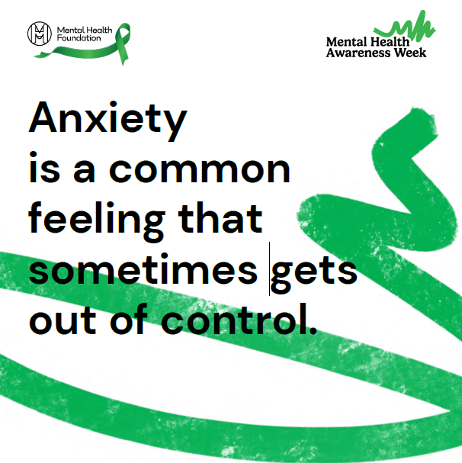
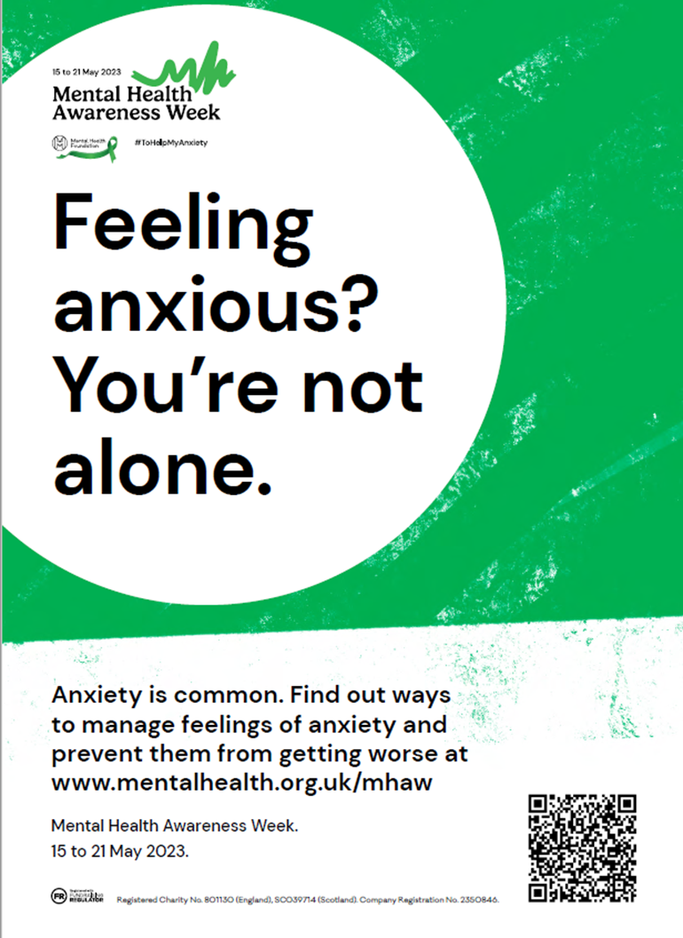
Notes:
Finally – remember anxiety is a common feeling that sometimes gets out of control but the good news is there are many ways to manage feeling of anxiety and prevent them from getting worse and interfering with your life.

